Slide 1
BINARY LOGIC & CRYPT ARITHMETIC
SHABANA

Slide 2



In an Island the natives lie and visitors speak truth. A man want to know whether a salesman besides him in a bar is a native or visitor. He asked
him to ask a woman besides him whether she is a native or visitor. He
replied “She says she is a visitors”, then he knew that the salesman is a
native or visitor. Find out salesman in which category, native or visitor?
Native
Visitor
Both native & visitor
Neither native nor visitor

Slide 3
If exactly one of these statements is false, which statement is false
Statement D is true
Statement A is false
Statement B is false
Statement C is true

Slide 4
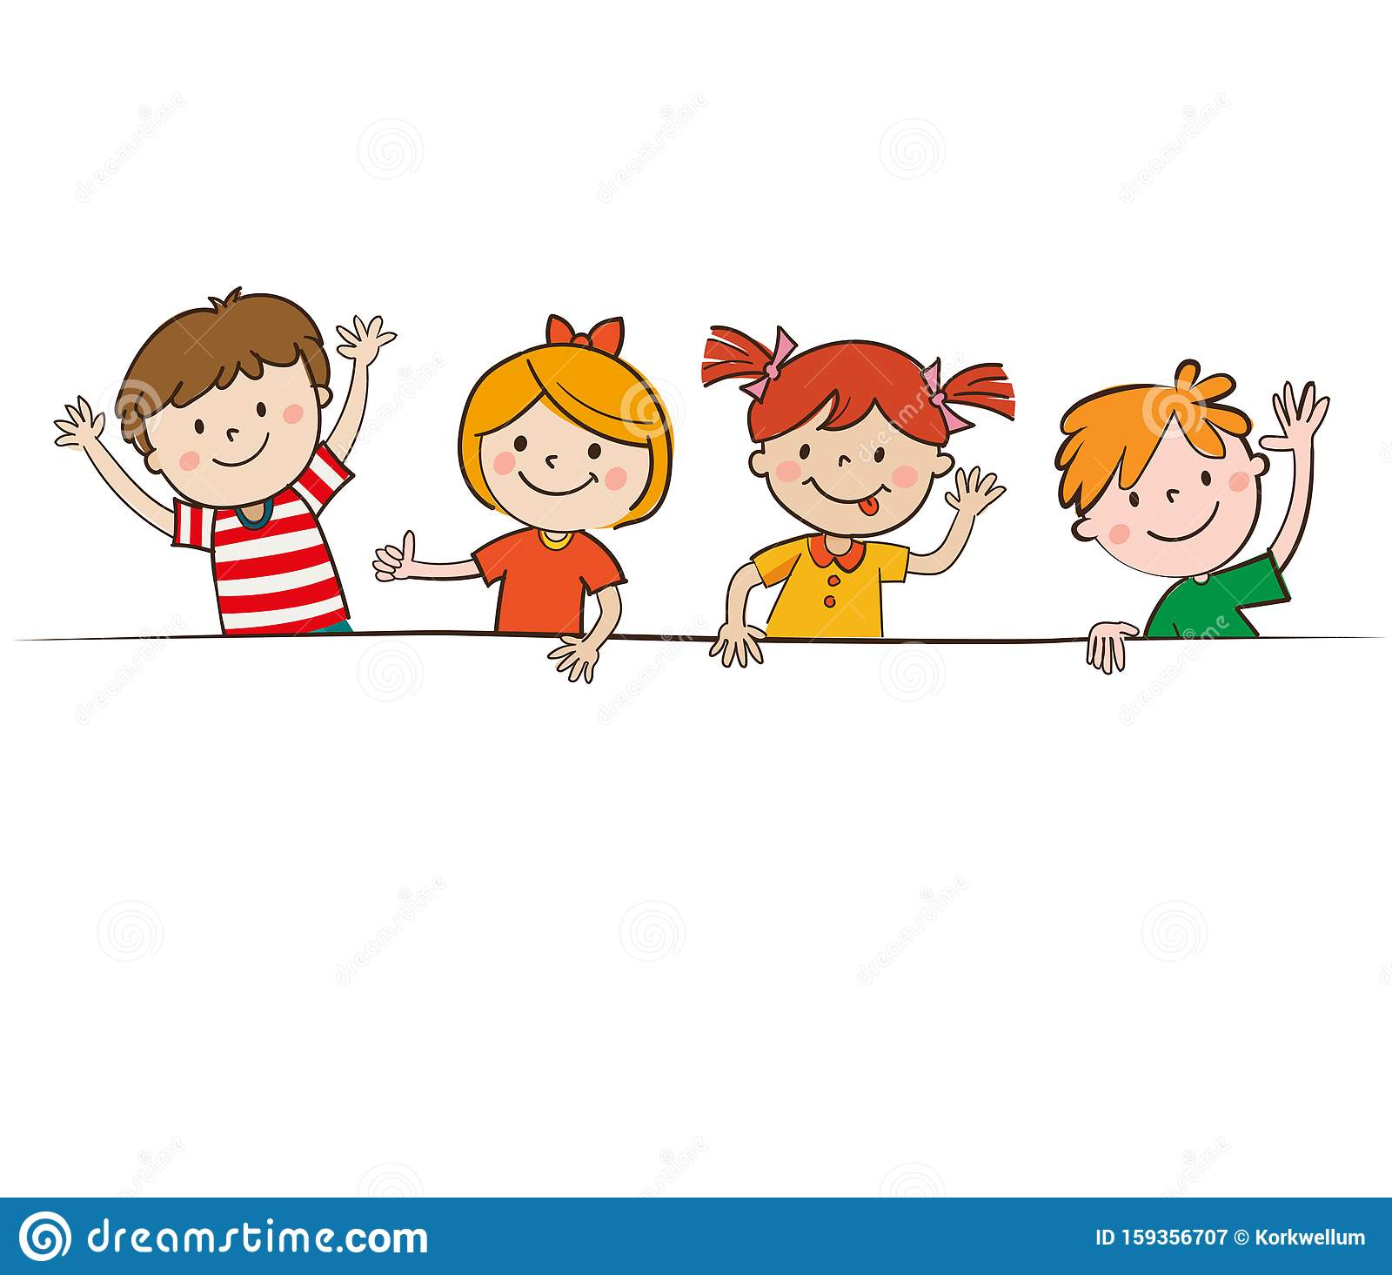
There are four kids that came from a birthday party. Each one of them got
either6, 7 or 8 chocolates in the party. Further, it is known that kid who got 7
chocolates always tell lie and kids with either 6 or 8 chocolates always tell the
truth. When asked for the total number of chocolates with them, each one gave
a different count of chocolates as follows.
E
28
25
26
27
A
S
Y
What is the actual count of the chocolates with all the 4 kids?

Slide 5
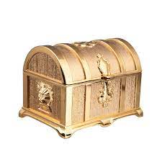
There are three boxes in a table. One of the box contains Gold
and the other two are empty. A printed message contains in
each box. One of the message is true and the other two are lies. The first box says “The Gold is not here”.
The second box says “The Gold is not here”.
The third box says “The Gold is in the second box”.
Which box has the Gold?

Slide 6
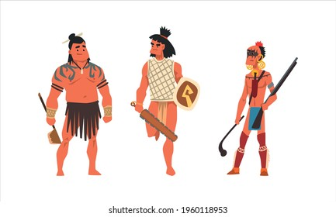
An island is inhabited by 3 tribes. Truth tellers who always speak truth, liars who
always lie and alternators who alternately speak truth. It is known that A, B and C, the 3 citizens of that island belong to those 3 different tribes in any order. When asked
about their tribes, they came up with the following replies:
Who among them is a liar?
Who among them is an alternator?
I am a truth
teller. B is a
liar
I am an alternator. C is a liar
I am a truth
teller. B is a
Liar.
A
B
C

Slide 7
CRYPT ARITHMETIC
Rules:
Each alphabet can be represented by the digits 0 -9 uniquely
2. Number should not begin zero
Eg: 0456 (wrong)
456 (correct)
There must be only one solution to the problems

Slide 8
YOU + YOUR = HEART
Assume O = 4, Find the value of Y + U + R + E
15
16
17
18

Slide 9
LET + LEE = ALL
Assume, E = 5, Find A + L + L
L
E
T
A

Slide 10
HERE = COMES - SHE
Assume, S = 8, Find R + H + O
12
13
14
15

Slide 11
EAT + EAT + EAT = BEET
Assume, T = 0, Find TEE + TEE
088
084
044
048

Slide 12
FIND THE NUMBER OF TRIANGLES

Slide 13
FIND THE NUMBER OF TRIANGLES

Slide 14

FIND THE NUMBER OF TRIANGLES

Slide 16

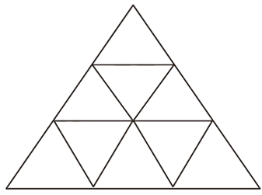

Slide 17
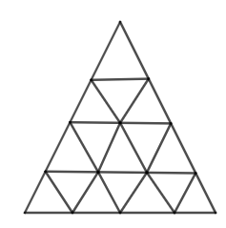
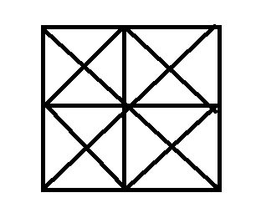

Slide 18
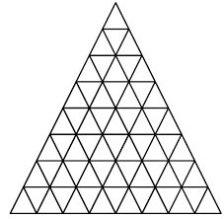

Slide 19
THANK YOU

